Slide 1



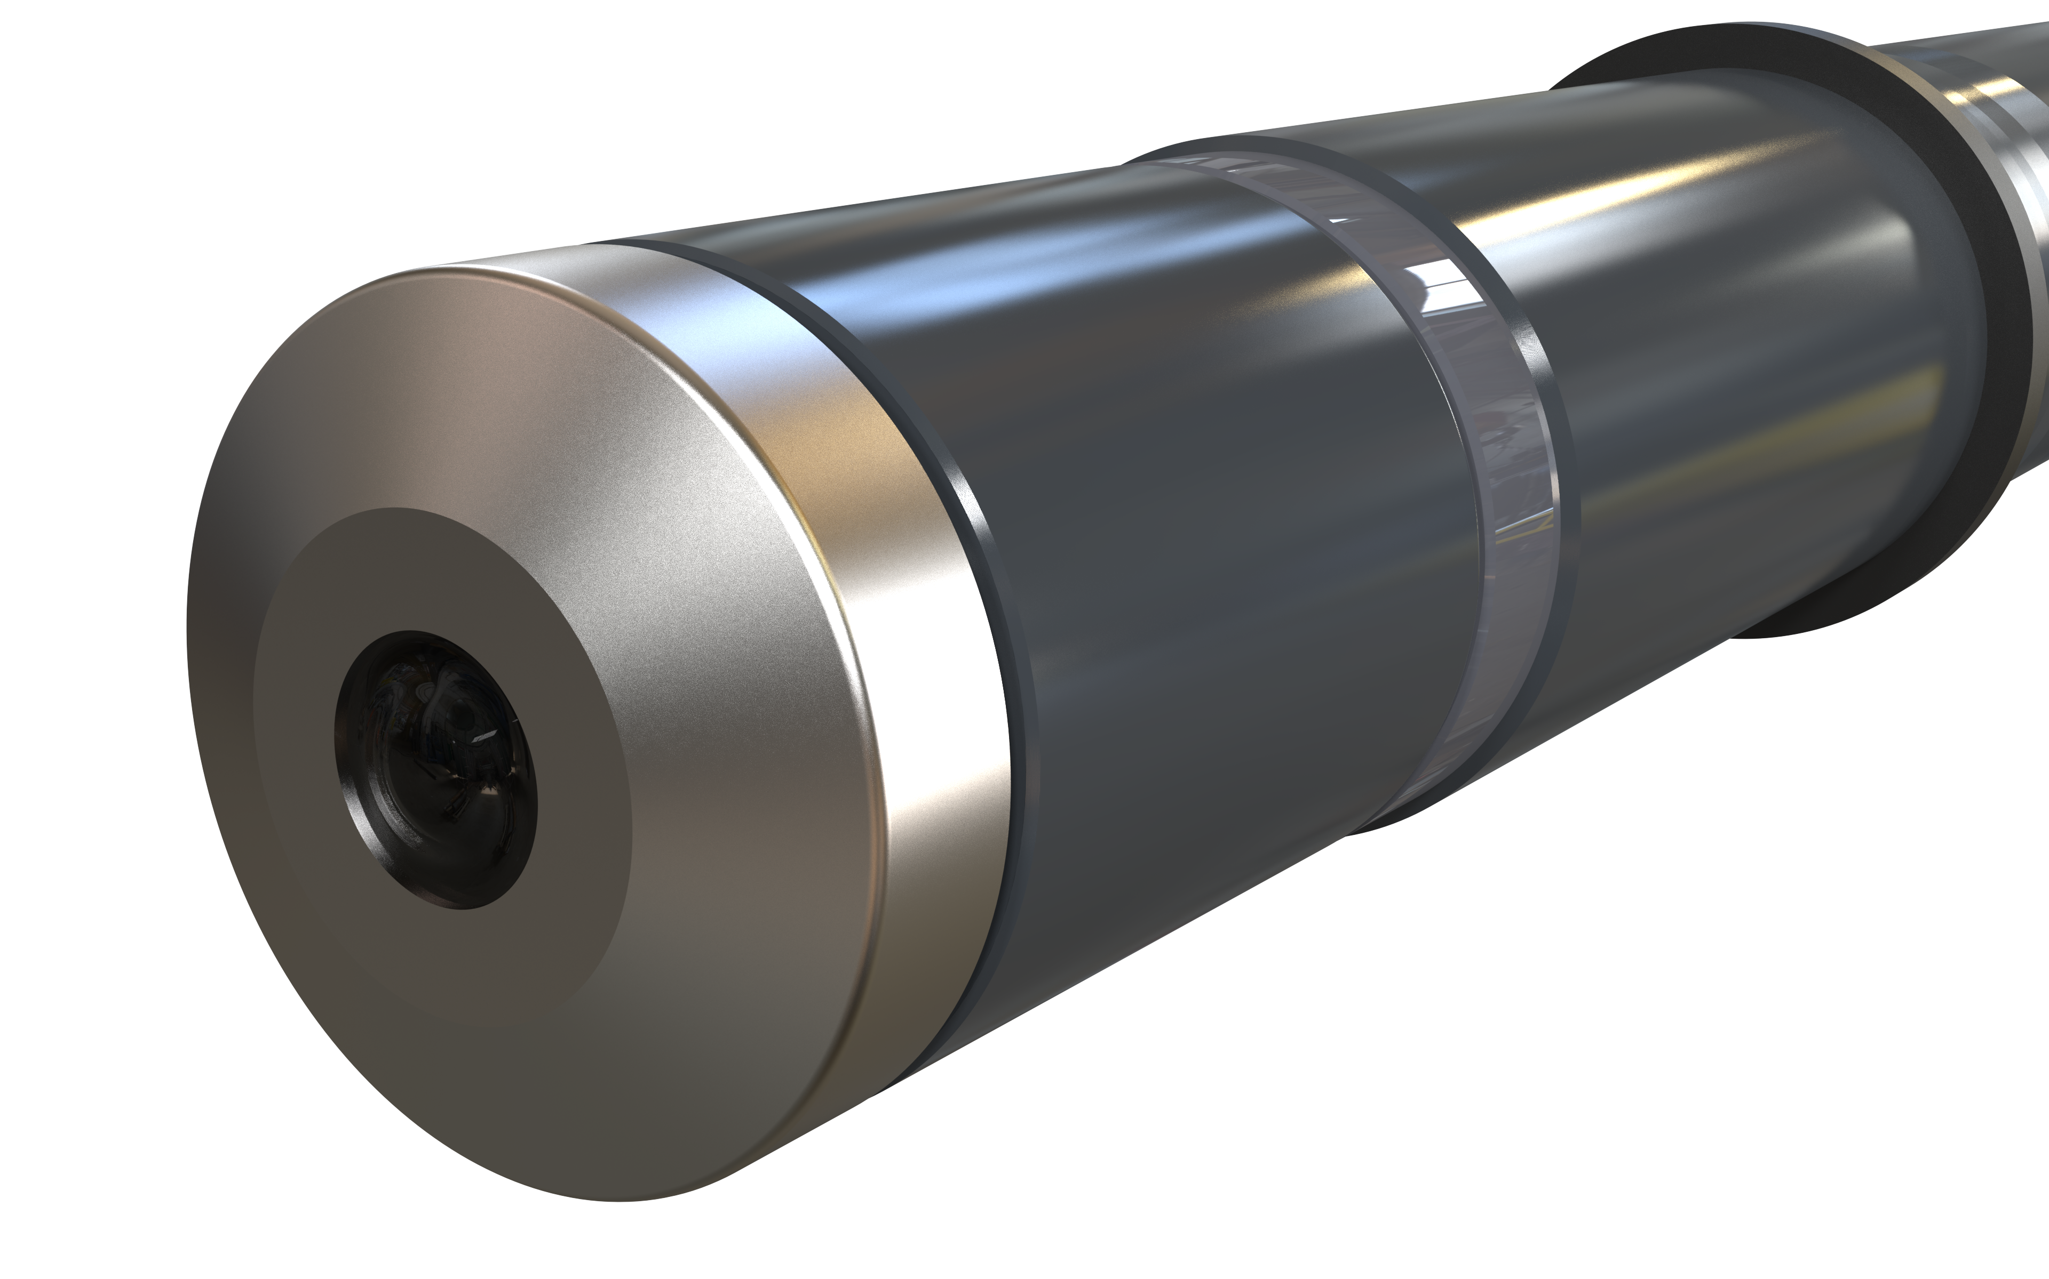

Sensor Maintenance
Ozone Sensor - OzoSense
www.processinstruments.net

